Slide 1
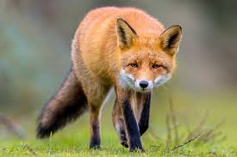
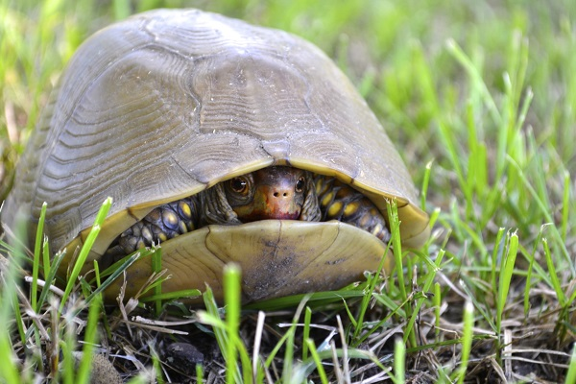
What is your natural conflict style?
High importance
Competing
Collaborating
Own goals
Compromising
Avoiding
Accommodating
Low importance
Relationship with the other person
High importance
Note: based on the Thomas-Kilmann conflict model
Notes:
TEMPLATE SLIDE ONLY.
Format: HELVETICA NEUE (font) Header: 40 points Body: 30 and 20 points (Point size can vary depending on your default)
Color Palette
Leadership: PMS 7456 CP Hex: #6C74B3
Strategy: PMS 7712 CP Hex: #00879D
Talent: PMS 7578 CP Hex: #DB6A37
Customer: PMS 711 CP Hex: #CE353A
Systems: PMS 124 CP Hex: #EBA700
Execution: PMS 7656 CP Hex: #8A3E82
Profit: PMS 377 CP Hex: #80A422
For design details, please refer to the 7 Attributes of Agile Growth Brand ID Guidelines

